Slide 1
COD Ch. 7 Large and Fast: Exploiting Memory Hierarchy

Slide 2
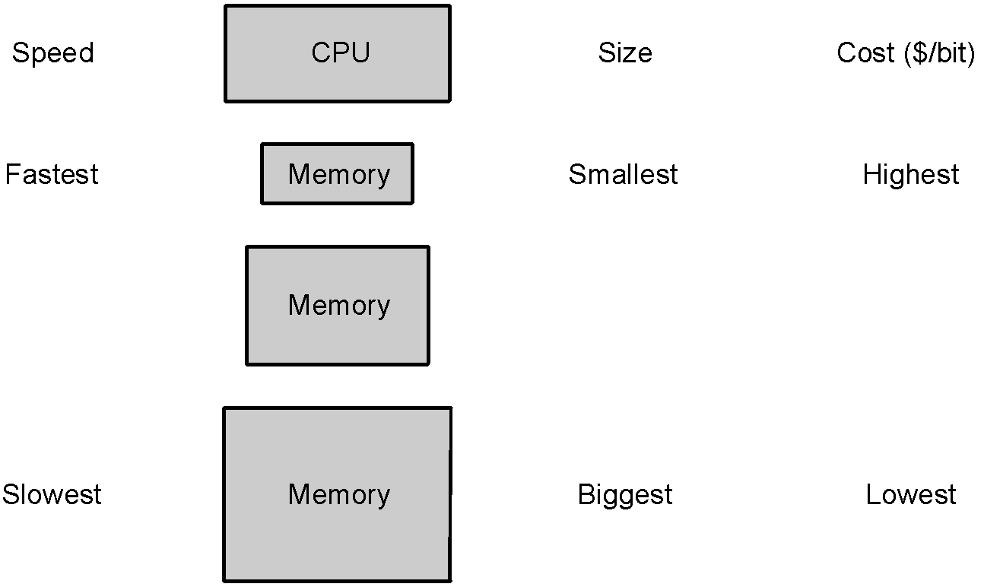
Memories: Review
DRAM (Dynamic Random Access Memory):
value is stored as a charge on capacitor that must be periodically refreshed, which is why it is called dynamic
very small – 1 transistor per bit – but factor of 5 to 10 slower than SRAM
used for main memory
SRAM (Static Random Access Memory):
value is stored on a pair of inverting gates that will exist indefinitely as long as there is power, which is why it is called static
very fast but takes up more space than DRAM – 4 to 6 transistors per bit
used for cache
Notes:
‹#›

Slide 3
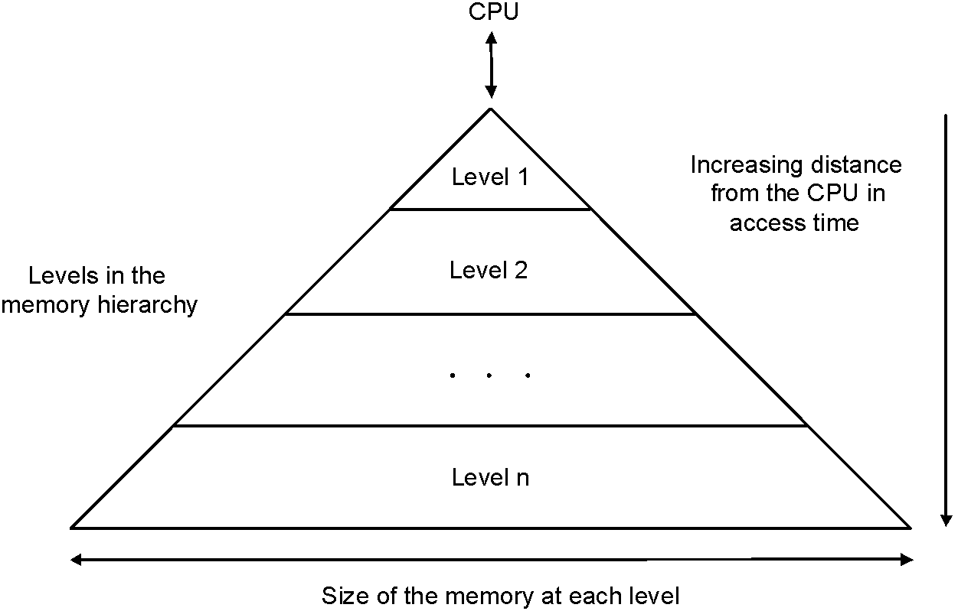
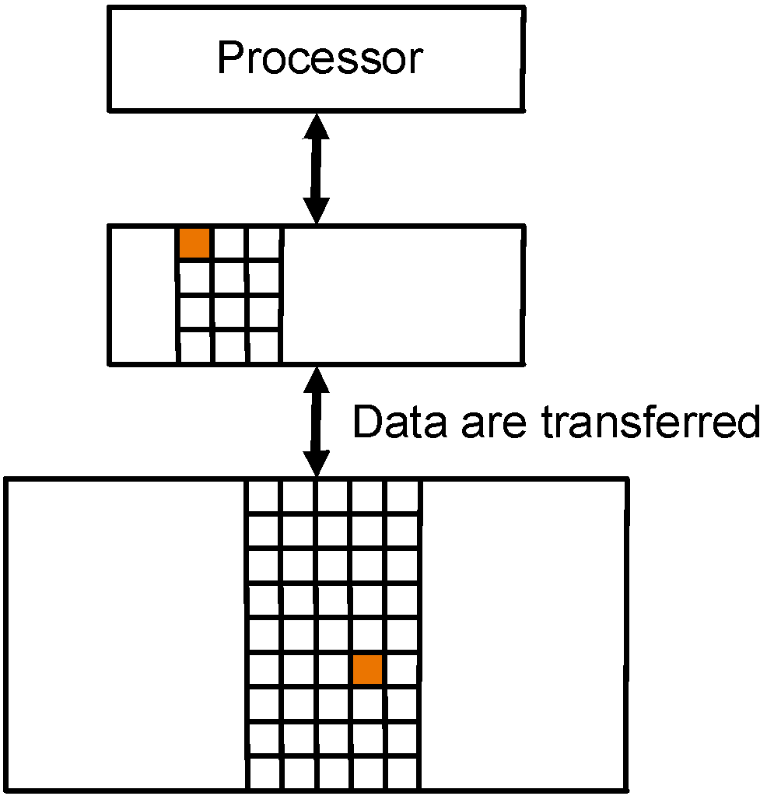
Memory Hierarchy
Users want large and fast memories…
expensive and they don’t like to pay…
Make it seem like they have what they want…
memory hierarchy
hierarchy is inclusive, every level is subset of lower level
performance depends on hit rates
Block of data
(unit of data copy)
Notes:
‹#›

Slide 4
Locality
Locality is a principle that makes having a memory hierarchy a good idea
If an item is referenced then because of
temporal locality: it will tend to be again referenced soon
spatial locality: nearby items will tend to be referenced soon
why does code have locality – consider instruction and data?
Notes:
‹#›

Slide 5
Hit and Miss
Focus on any two adjacent levels – called, upper (closer to CPU) and lower (farther from CPU) – in the memory hierarchy, because each block copy is always between two adjacent levels
Terminology:
block: minimum unit of data to move between levels
hit: data requested is in upper level
miss: data requested is not in upper level
hit rate: fraction of memory accesses that are hits (i.e., found at upper level)
miss rate: fraction of memory accesses that are not hits
miss rate = 1 – hit rate
hit time: time to determine if the access is indeed a hit + time to access and deliver the data from the upper level to the CPU
miss penalty: time to determine if the access is a miss + time to replace block at upper level with corresponding block at lower level + time to deliver the block to the CPU

Slide 6
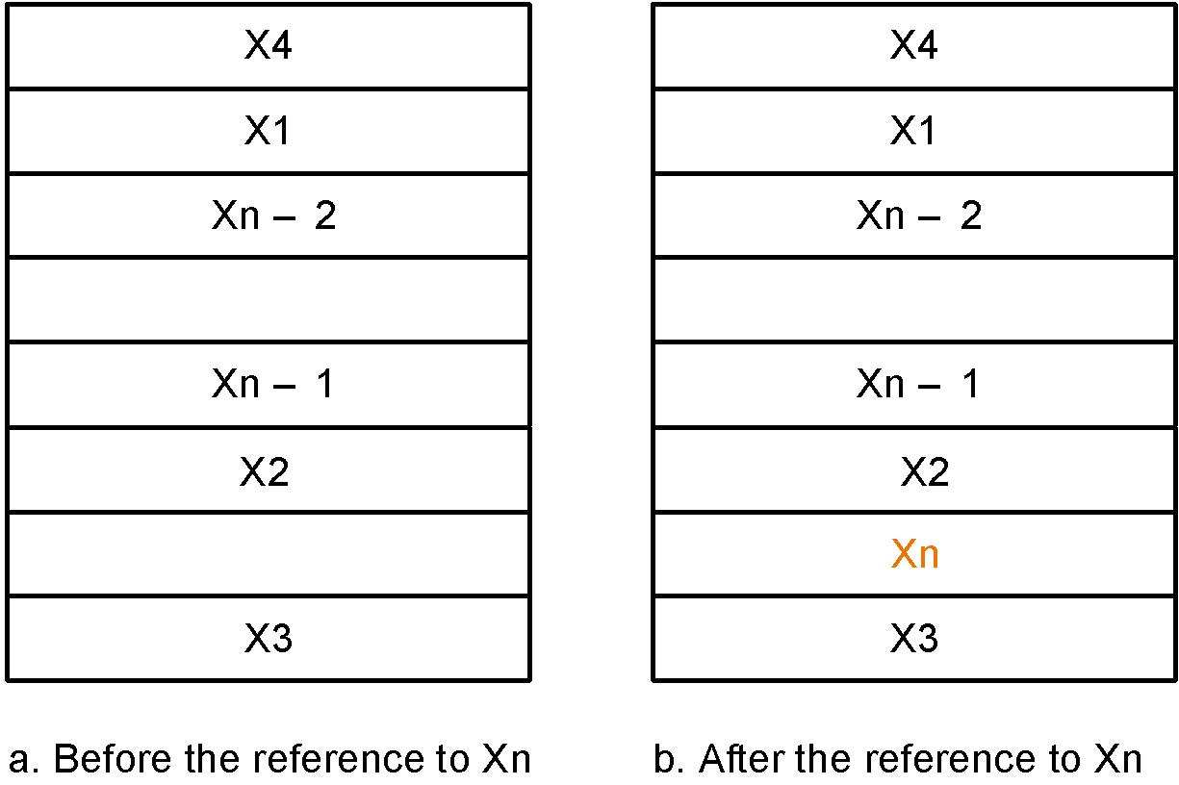
Caches
By simple example
assume block size = one word of data
Issues:
how do we know if a data item is in the cache?
if it is, how do we find it?
if not, what do we do?
Solution depends on cache addressing scheme…
Reference to X_{n}
causes miss so
it is fetched from
memory
Notes:
‹#›

Slide 7
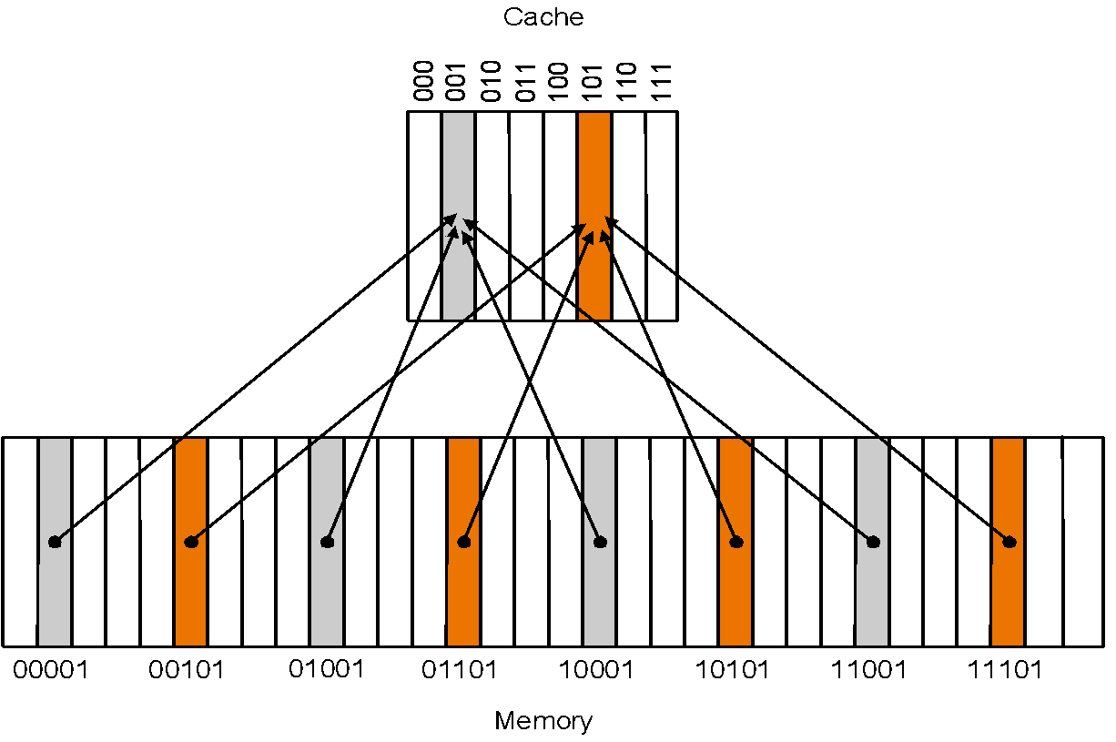
Direct Mapped Cache
Addressing scheme in direct mapped cache:
cache block address = memory block address mod cache size (unique)
if cache size = 2^{m}, cache address = lower m bits of n-bit memory address
remaining upper n-m bits kept kept as tag bits at each cache block
also need a valid bit to
recognize valid entry
Notes:
‹#›

Slide 8
Accessing Cache
Example:
(0) Initial state:
(1) Address referred 10110 (miss):
Index V Tag Data
000 N
001 N
010 N
011 N
100 N
101 N
110 N
111 N
Index V Tag Data
000 N
001 N
010 N
011 N
100 N
101 N
110 Y 10 Mem(10110)
111 N

Slide 9
(2) Address referred 11010 (miss):
(3) Address referred 10110 (hit):
Index V Tag Data
000 N
001 N
010 Y 11 Mem(11010)
011 N
100 N
101 N
110 Y 10 Mem(10110)
111 N
Index V Tag Data
000 N
001 N
010 Y 11 Mem(11010)
011 N
100 N
101 N
110 Y 10 Mem(10110)
111 N
to CPU
(4) Address referred 10010 (miss):
Index V Tag Data
000 N
001 N
010 Y 10 Mem(10010)
011 N
100 N
101 N
110 Y 10 Mem(10110)
111 N

Slide 10
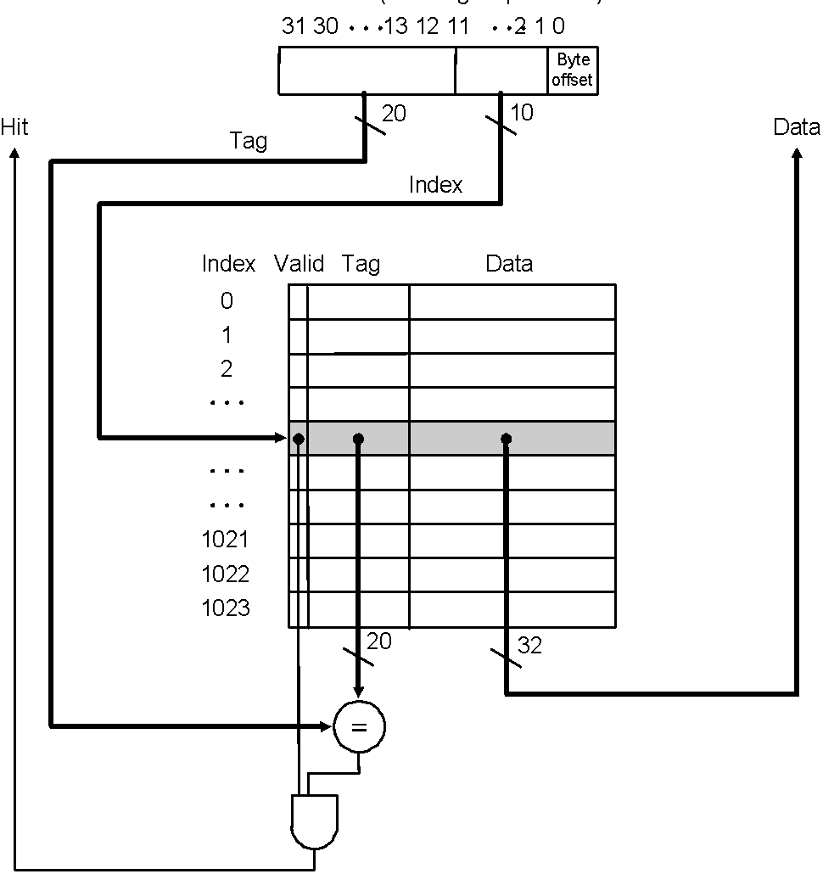
Direct Mapped Cache
Address showing bit positions
MIPS style:
What kind of locality are we taking advantage of?
Cache with 1024 1-word blocks: byte offset
(least 2 significant bits) is ignored and
next 10 bits used to index into cache
Notes:
‹#›

Slide 11
Cache Read Hit/Miss
Cache read hit: no action needed
Instruction cache read miss:
Send original PC value (current PC – 4, as PC has already been incremented in first step of instruction cycle) to memory
Instruct main memory to perform read and wait for memory to complete access – stall on read
After read completes write cache entry
Restart instruction execution at first step to refetch instruction
Data cache read miss:
Similar to instruction cache miss
To reduce data miss penalty allow processor to execute instructions while waiting for the read to complete until the word is required – stall on use (why won’t this work for instruction misses?)

Slide 12
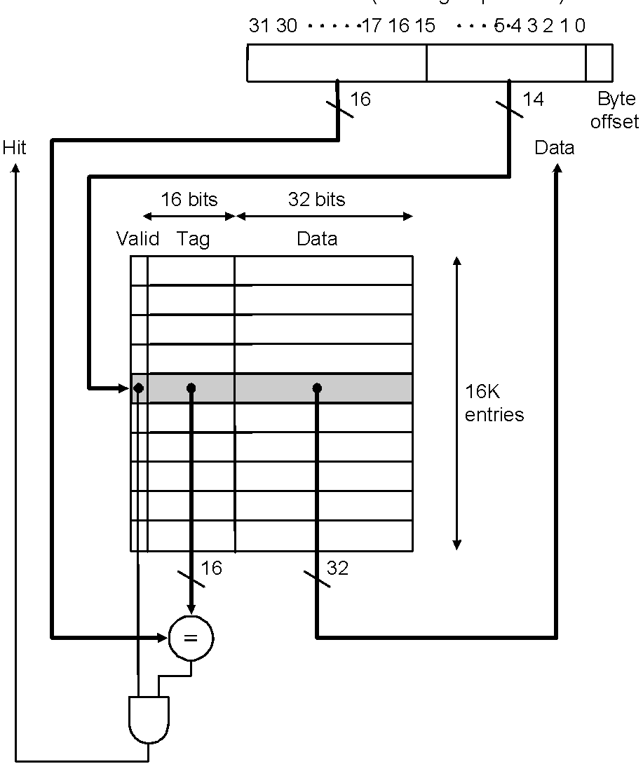
DECStation 3100 Cache (MIPS R2000 processor)
Address showing bit positions
Cache with 16K 1-word blocks: byte offset
(least 2 significant bits) is ignored and
next 14 bits used to index into cache

Slide 13
Cache Write Hit/Miss
Write-through scheme
on write hit: replace data in cache and memory with every write hit to avoid inconsistency
on write miss: write the word into cache and memory – obviously no need to read missed word from memory!
Write-through is slow because of always required memory write
performance is improved with a write buffer where words are stored while waiting to be written to memory – processor can continue execution until write buffer is full
when a word in the write buffer completes writing into main that buffer slot is freed and becomes available for future writes
DEC 3100 write buffer has 4 words
Write-back scheme
write the data block only into the cache and write-back the block to main only when it is replaced in cache
more efficient than write-through, more complex to implement
Notes:
‹#›

Slide 14
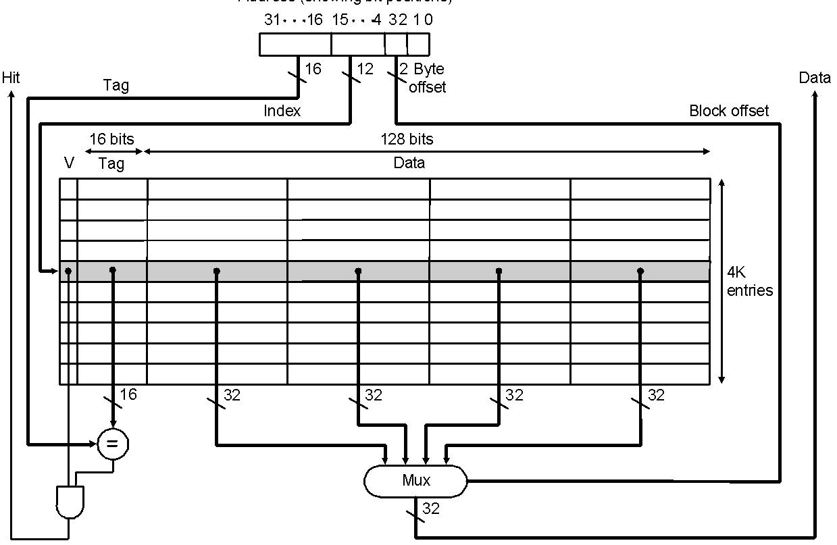
Direct Mapped Cache: Taking Advantage of Spatial Locality
Taking advantage of spatial locality with larger blocks:
Address showing bit positions
Cache with 4K 4-word blocks: byte offset (least 2 significant bits) is ignored, next 2 bits are block offset, and the next 12 bits are used to index into cache
Notes:
‹#›

Slide 15
Direct Mapped Cache: Taking Advantage of Spatial Locality
Cache replacement in large (multiword) blocks:
word read miss: read entire block from main memory
word write miss: cannot simply write word and tag! Why?!
writing in a write-through cache:
if write hit, i.e., tag of requested address and and cache entry are equal, continue as for 1-word blocks by replacing word and writing block to both cache and memory
if write miss, i.e., tags are unequal, fetch block from memory, replace word that caused miss, and write block to both cache and memory
therefore, unlike case of 1-word blocks, a write miss with a multiword block causes a memory read

Slide 16
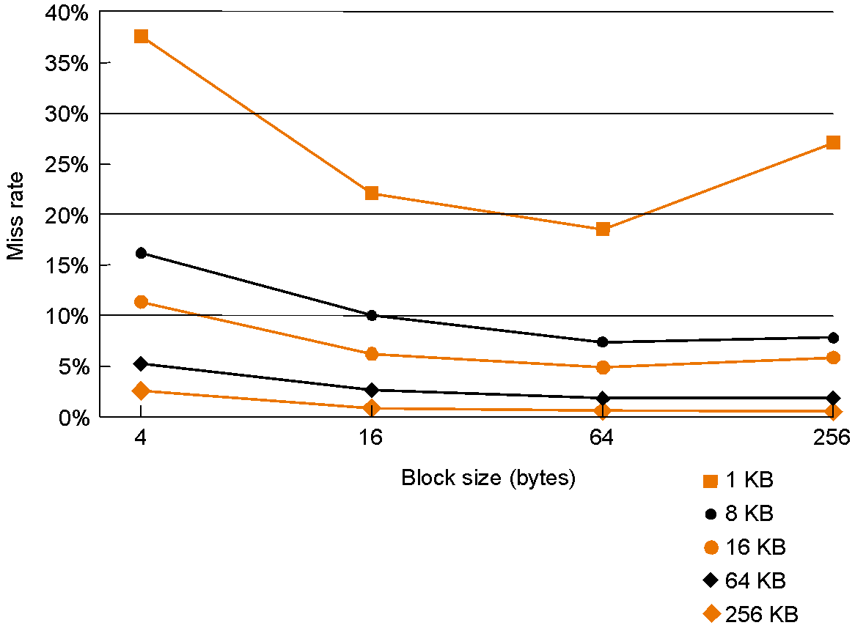
Direct Mapped Cache: Taking Advantage of Spatial Locality
Miss rate falls at first with increasing block size as expected, but, as block size becomes a large fraction of total cache size, miss rate may go up because
there are few blocks
competition for blocks increases
blocks get ejected before most of their words are accessed (thrashing in cache)
Miss rate vs. block size for
various cache sizes

Slide 17
Example Problem
How many total bits are required for a direct-mapped cache with 128 KB of data and 1-word block size, assuming a 32-bit address?
Cache data = 128 KB = 2¹⁷ bytes = 2¹⁵ words = 2¹⁵ blocks
Cache entry size = block data bits + tag bits + valid bit
= 32 + (32 – 15 – 2) + 1 = 48 bits
Therefore, cache size = 2¹⁵ × 48 bits = 2¹⁵ × (1.5 × 32) bits = 1.5 × 2²⁰ bits = 1.5 Mbits
data bits in cache = 128 KB × 8 = 1 Mbits
total cache size/actual cache data = 1.5

Slide 18
Example Problem
How many total bits are required for a direct-mapped cache with 128 KB of data and 4-word block size, assuming a 32-bit address?
Cache size = 128 KB = 2¹⁷ bytes = 2¹⁵ words = 2¹³ blocks
Cache entry size = block data bits + tag bits + valid bit
= 128 + (32 – 13 – 2 – 2) + 1 = 144 bits
Therefore, cache size = 2¹³ × 144 bits = 2¹³ × (1.25 × 128) bits = 1.25 × 2²⁰ bits = 1.25 Mbits
data bits in cache = 128 KB × 8 = 1 Mbits
total cache size/actual cache data = 1.25

Slide 19
Example Problem
Consider a cache with 64 blocks and a block size of 16 bytes. What block number does byte address 1200 map to?
As block size = 16 bytes:
byte address 1200 ⇒ block address ⎣1200/16 ⎦ = 75
As cache size = 64 blocks:
block address 75 ⇒ cache block (75 mod 64) = 11

Slide 20
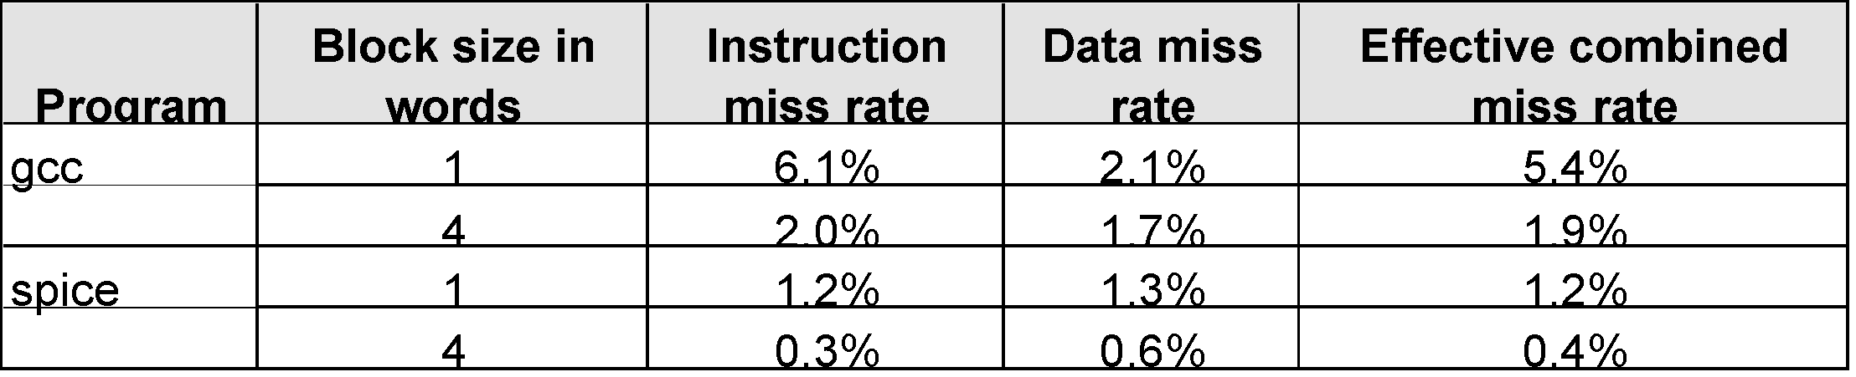
Improving Cache Performance
Use split caches for instruction and data because there is more spatial locality in instruction references:
Make reading multiple words (higher bandwidth) possible by increasing physical or logical width of the system…
Miss rates for gcc and spice in a MIPS R2000
with one and four word block sizes
Notes:
‹#›

Slide 21
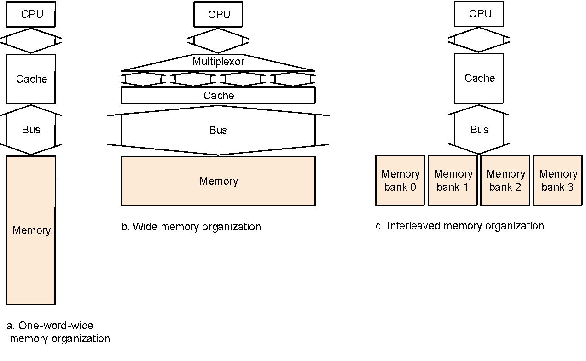
Improving Cache Performance by Increasing Bandwidth
Assume:
cache block of 4 words
1 clock cycle to send address to memory address buffer (1 bus trip)
15 clock cycles for each memory data access
1 clock cycle to send data to memory data buffer (1 bus trip)
Bus
Proce-
ssor
Memory
bank 0
Memory
bank 1
Memory
bank 2
Memory
bank 3
Interleaved memory units
compete for bus
4 word wide memory and bus
4 word wide memory only
1 + 1*15 +1*1 = 17 cycles
1 +1*15 + 4*1 = 20 cycles
Miss penalties
1 + 4*15 + 4*1 = 65 cycles
Notes:
‹#›

Slide 22
Performance
Simplified model assuming equal read and write miss penalties:
CPU time = (execution cycles + memory stall cycles) × cycle time
memory stall cycles = memory accesses × miss rate × miss penalty
Therefore, two ways to improve performance in cache:
decrease miss rate
decrease miss penalty
what happens if we increase block size?
Notes:
‹#›

Slide 23
Example Problems
Assume for a given machine and program:
instruction cache miss rate 2%
data cache miss rate 4%
miss penalty always 40 cycles
CPI of 2 without memory stalls
frequency of load/stores 36% of instructions
How much faster is a machine with a perfect cache that never misses?
What happens if we speed up the machine by reducing its CPI to 1 without changing the clock rate?
What happens if we speed up the machine by doubling its clock rate, but if the absolute time for a miss penalty remains same?

Slide 24
Solution
1.
Assume instruction count = I
Instruction miss cycles = I × 2% × 40 = 0.8 × I
Data miss cycles = I × 36% × 4% × 40 = 0.576 × I
So, total memory-stall cycles = 0.8 × I + 0.576 × I = 1.376 × I
in other words, 1.376 stall cycles per instruction
Therefore, CPI with memory stalls = 2 + 1.376 = 3.376
Assuming instruction count and clock rate remain same for a perfect cache and a cache that misses:
CPU time with stalls / CPU time with perfect cache
= 3.376 / 2 = 1.688
Performance with a perfect cache is better by a factor of 1.688

Slide 25
Solution (cont.)
2.
CPI without stall = 1
CPI with stall = 1 + 1.376 = 2.376 (clock has not changed so stall cycles per instruction remains same)
CPU time with stalls / CPU time with perfect cache
= CPI with stall / CPI without stall
= 2.376
Performance with a perfect cache is better by a factor of 2.376
Conclusion: with higher CPI cache misses “hurt more” than with lower CPI

Slide 26
Solution (cont.)
3.
With doubled clock rate, miss penalty = 2 × 40 = 80 clock cycles
Stall cycles per instruction = (I × 2% × 80) + (I × 36% × 4% × 80)
= 2.752 × I
So, faster machine with cache miss has CPI = 2 + 2.752 = 4.752
CPU time with stalls / CPU time with perfect cache
= CPI with stall / CPI without stall
= 4.752 / 2 = 2.376
Performance with a perfect cache is better by a factor of 2.376
Conclusion: with higher clock rate cache misses “hurt more” than with lower clock rate

Slide 27
Decreasing Miss Rates with Associative Block Placment
Direct mapped: one unique cache location for each memory block
cache block address = memory block address mod cache size
Fully associative: each memory block can locate anywhere in cache
all cache entries are searched (in parallel) to locate block
Set associative: each memory block can place in a unique set of cache locations – if the set is of size n it is n-way set-associative
cache set address = memory block address mod number of sets in cache
all cache entries in the corresponding set are searched (in parallel) to locate block
Increasing degree of associativity
reduces miss rate
increases hit time because of the parallel search and then fetch

Slide 28
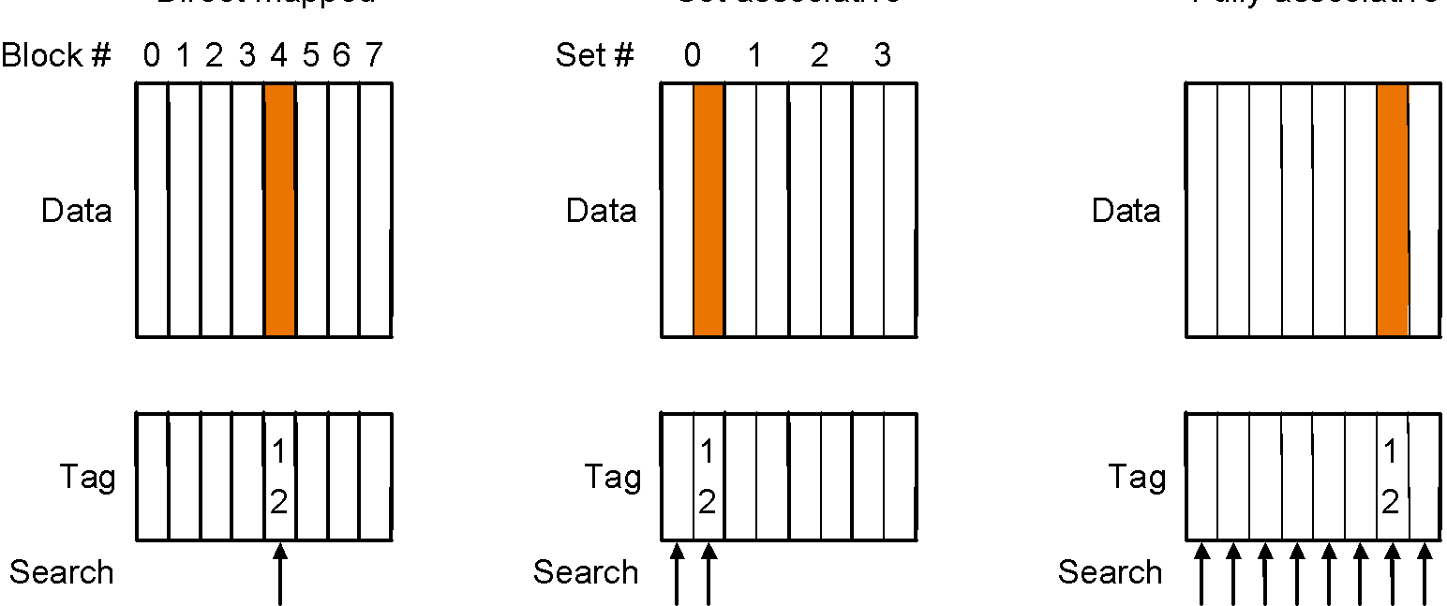
Decreasing Miss Rates with Associative Block Placment
Direct Mapped
2-way Set Associative
Fully Associative
12 mod 8 = 4
12 mod 4 = 0
Location of a memory block with address 12 in a cache with 8 blocks
with different degrees of associativity
Notes:
‹#›

Slide 29
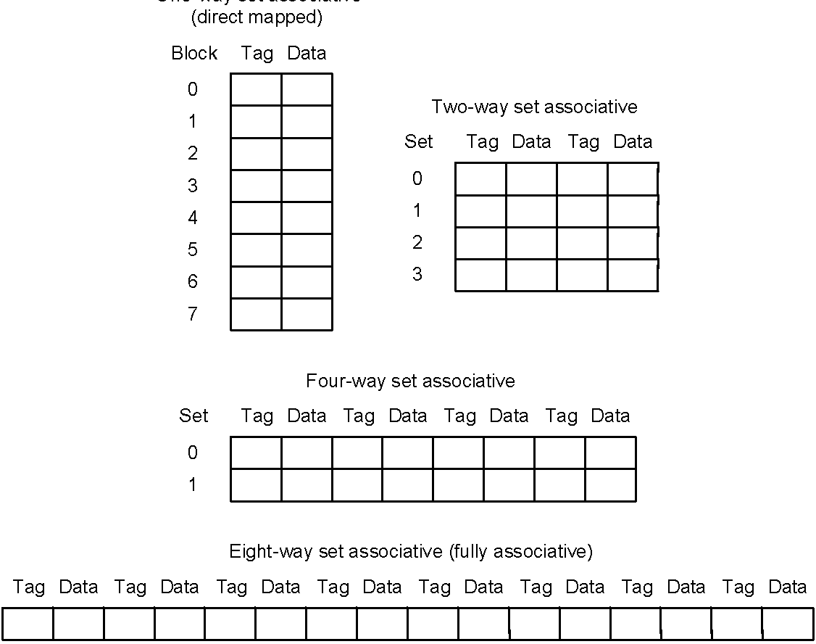
Decreasing Miss Rates with Associative Block Placment
One-way set associative
Configurations of an 8-block cache with different degrees of associativity

Slide 30
Example Problems
Find the number of misses for a cache with four 1-word blocks given the following sequence of memory block accesses: 0, 8, 0, 6, 8, for each of the following cache configurations
direct mapped
2-way set associative (use LRU replacement policy)
fully associative
Note about LRU replacement
in a 2-way set associative cache LRU replacement can be implemented with one bit at each set whose value indicates the mostly recently referenced block

Slide 31
Solution
1 (direct-mapped)
5 misses
Block address Cache block
0 0 (= 0 mod 4)
6 2 (= 6 mod 4)
8 0 (= 8 mod 4)
Block address translation in direct-mapped cache
Address of memory Hit or Contents of cache blocks after reference
block accessed miss 0 1 2 3
0 miss Memory[0]
8 miss Memory[8]
0 miss Memory[0]
6 miss Memory[0] Memory[6]
8 miss Memory[8] Memory[6]
Cache contents after each reference – red indicates new entry added

Slide 32
Solution (cont.)
2 (two-way set-associative)
Four misses
Block address Cache set
0 0 (= 0 mod 2)
6 0 (= 6 mod 2)
8 0 (= 8 mod 2)
Block address translation in a two-way set-associative cache
Address of memory Hit or Contents of cache blocks after reference
block accessed miss Set 0 Set 0 Set 1 Set 1
0 miss Memory[0]
8 miss Memory[0] Memory[8]
0 hit Memory[0] Memory[8]
6 miss Memory[0] Memory[6]
8 miss Memory[8] Memory[6]
Cache contents after each reference – red indicates new entry added

Slide 33
Solution (cont.)
3 (fully associative)
3 misses
Address of memory Hit or Contents of cache blocks after reference
block accessed miss Block 0 Block 1 Block 2 Block 3
0 miss Memory[0]
8 miss Memory[0] Memory[8]
0 hit Memory[0] Memory[8]
6 miss Memory[0] Memory[8] Memory[6]
8 hit Memory[0] Memory[8] Memory[6]
Cache contents after each reference – red indicates new entry added

Slide 34
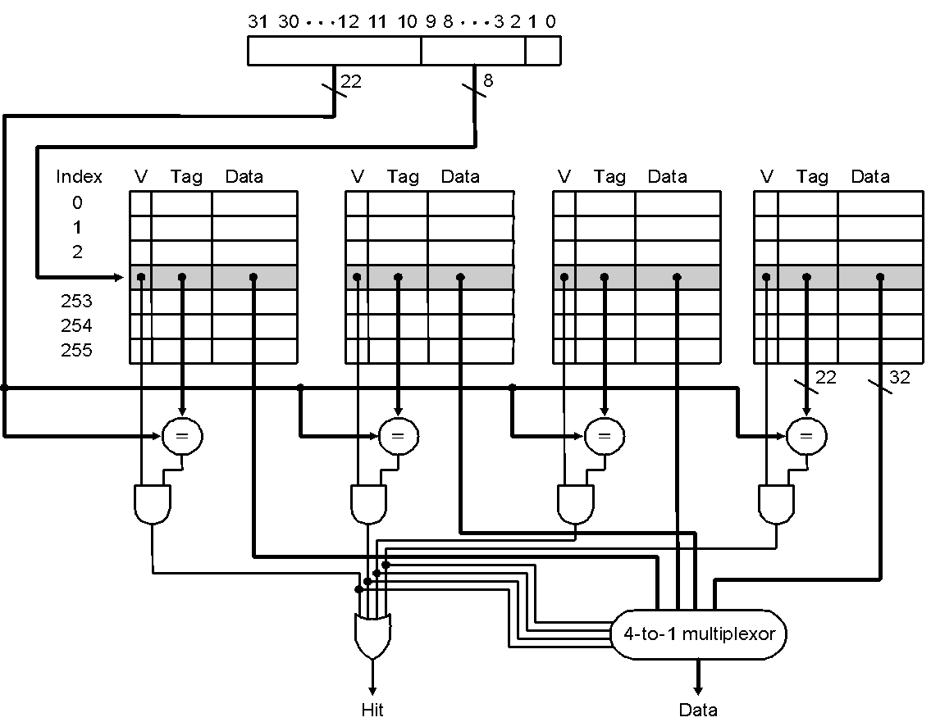
Implementation of a Set-Associative Cache
Address
Set
4-way set-associative cache with 4 comparators and one 4-to-1 multiplexor:
size of cache is 1K blocks = 256 sets * 4-block set size
Notes:
‹#›

